Slide 1



SPOTLIGHT SESSION
IMI MT and MX Releases
Rohini Vidhya R
Copyright © 2025 Accenture. All rights reserved.

Slide 2
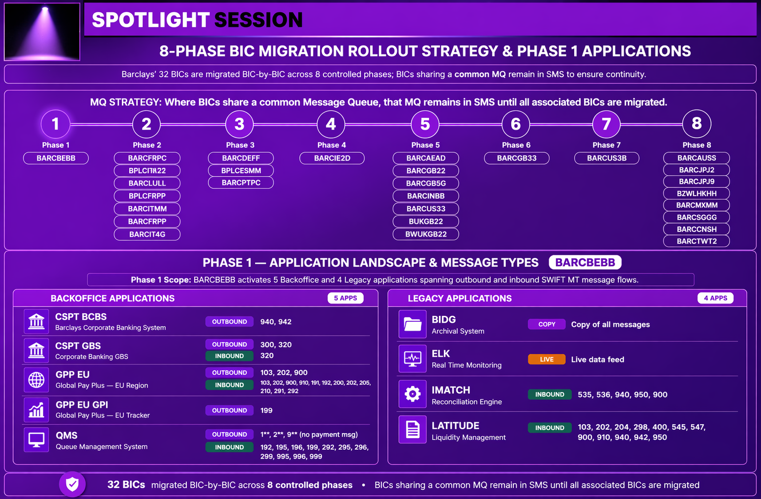

Slide 3
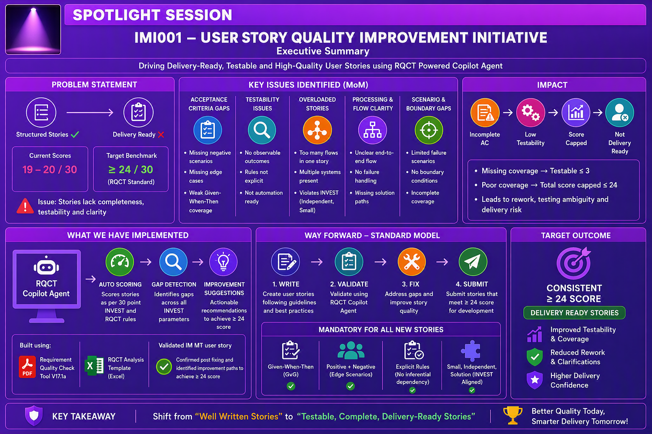

Slide 4
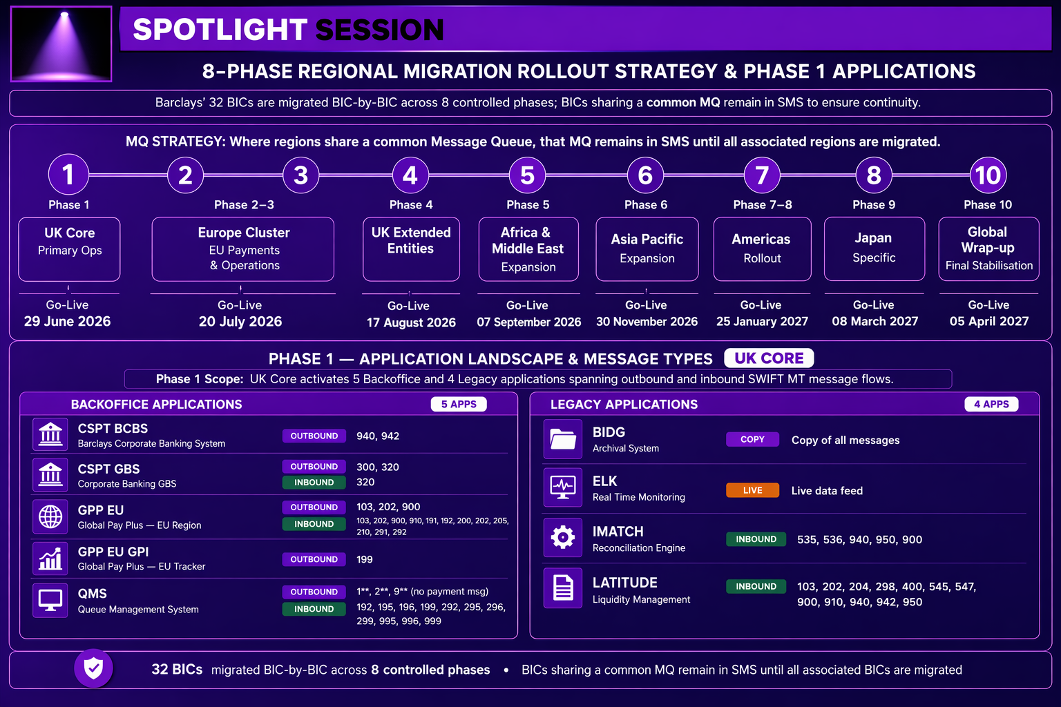

Slide 5
8-Phase Regional Migration Rollout Strategy
Release 3 | Phase 2 and Phase 3 migrated 08 August 2026 | Technical go-live completed 05 June 2026
TECHNICAL GO-LIVE
PHASE 1 GO-LIVE
PHASE 2 & 3 GO-LIVE
PHASE 4 GO-LIVE
PHASES 5-8
05 Jun 2026
05 Jul 2026
08 Aug 2026
10 Sep 2026
Oct 2026 - Jan 2027
1
2
3
4
5
6
7
8
UK Core
Europe Cluster
Europe Extended
Africa & Middle East
Asia Pacific
Americas
Japan
Global Wrap-up
United Kingdom
FR / IT / NL / LU
DE / ES / PT
AF / ME entities
APAC expansion
US / LATAM rollout
Japan specific
Final stabilisation
05 Jul 2026
08 Aug 2026
08 Aug 2026
10 Sep 2026
10 Oct 2026
10 Nov 2026
10 Dec 2026
10 Jan 2027
LIVE
LIVE
LIVE
PLANNED
TENTATIVE
TENTATIVE
TENTATIVE
TENTATIVE
Successfully gone live
Planned
Tentative - to be confirmed
11
BICs live in Release 3
7
Countries covered
11
Backoffice applications
4
Legacy applications
8 in Phase 2 + 3 in Phase 3
UK, FR, IT, NL, LU, DE, ES, PT
Phase 1 core + Phase 2 additions
BIDG, ELK, IMATCH, LATITUDE

Slide 6
Release 3 - BICs and Applications in Scope
All entities in Europe | Phase 2 and Phase 3 gone live 08 August 2026
BICS IN SCOPE
BACKOFFICE APPLICATIONS IN SCOPE
Region: Europe for every entity listed below
Phase 1 applications retained; Phase 2 additions highlighted
PHASE 2 - GONE LIVE 08 AUG 2026
PHASE 1 - CARRIED FORWARD
BIC
COUNTRY
REGION
BCBS
GBS
GPP EU
GPP EU GPI
BARCFRPC
FR - France
Europe
BPLCITMM
IT - Italy
Europe
NEWLY ADDED IN PHASE 2
BARCNL22
NL - Netherlands
Europe
CEDACRI
POM RELAY
SCREENING SEC OPS
TRADE
BARCLULL
LU - Luxembourg
Europe
BPLCFRPP
FR - France
Europe
TAURUS
TRIDENT BLUE
BIDG
BARCITMM
IT - Italy
Europe
BARCFRPP
FR - France
Europe
BARCIT4G
IT - Italy
Europe
LEGACY APPLICATIONS
PHASE 3 - GONE LIVE 08 AUG 2026
BIC
COUNTRY
REGION
BIDG
ELK
BARCDEFF
DE - Germany
Europe
Archival system
Real-time monitoring
BPLCESMM
ES - Spain
Europe
IMATCH
LATITUDE
BARCPTPC
PT - Portugal
Europe
Reconciliation engine
Liquidity management

Slide 7
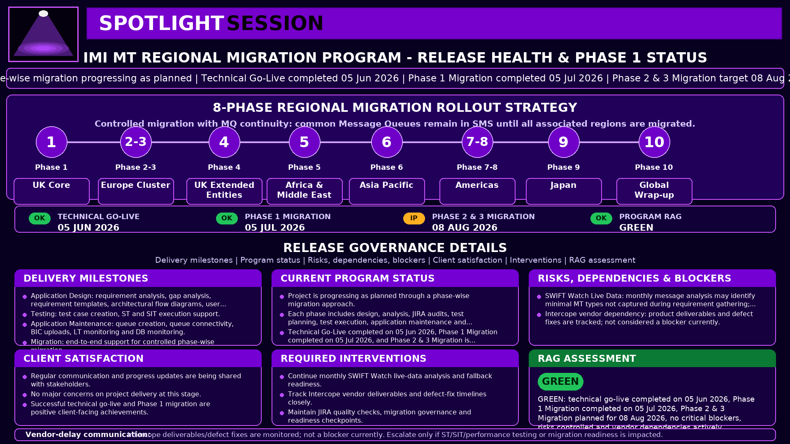

Slide 8
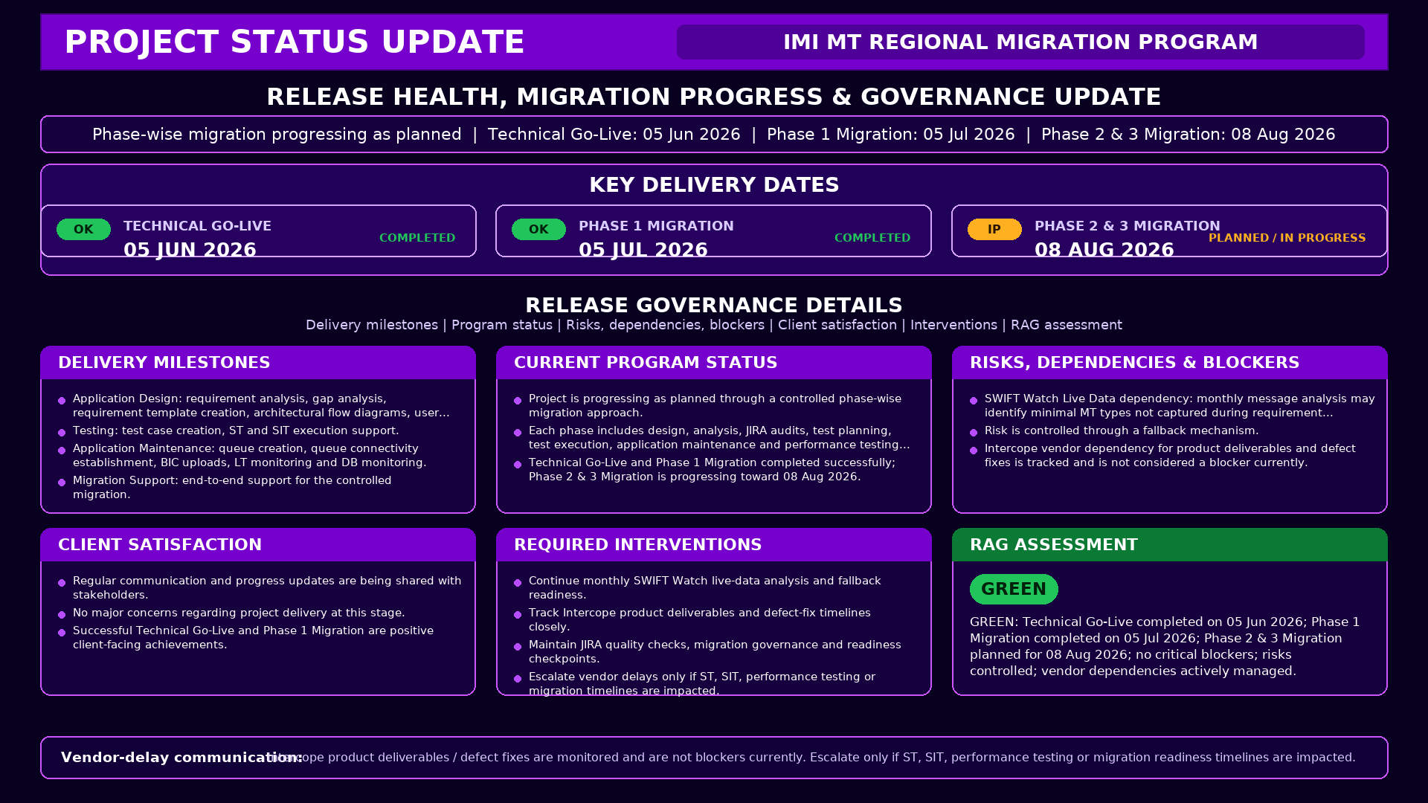

Slide 9
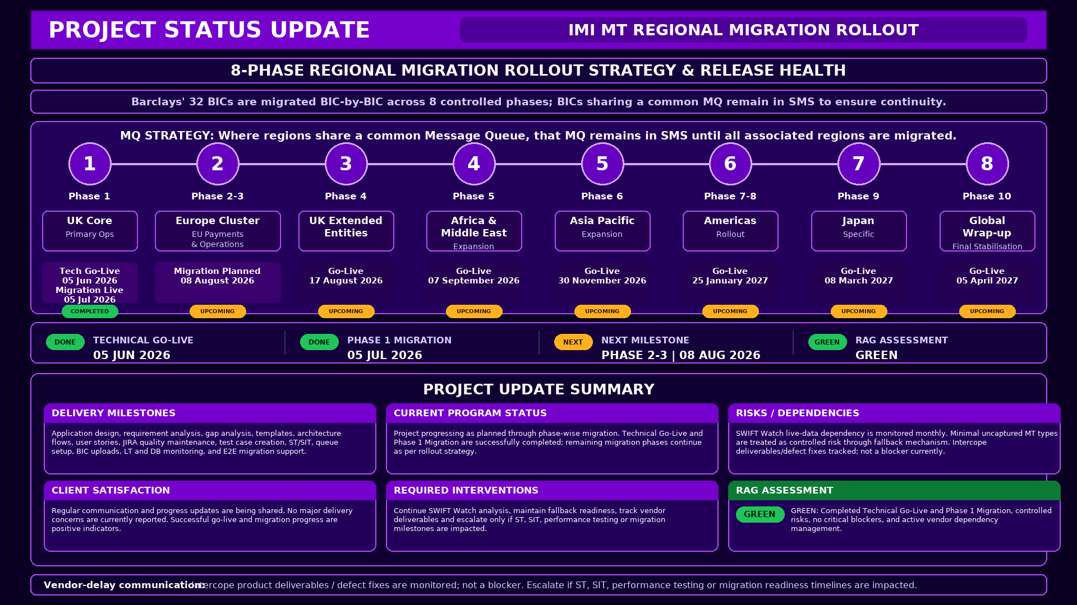

Slide 11
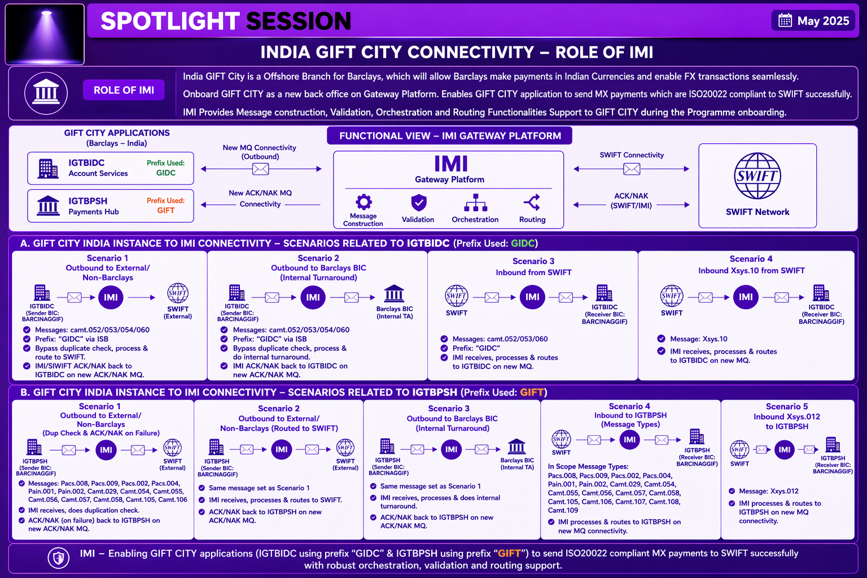

Slide 12


